Slide 1


Slide 2
PRESCRIPTIVE PROCESS MODELS
They prescribe a set of process elements—framework activities, software engineering actions, tasks, work products, quality assurance, and change control mechanisms for each project.
Each process model also prescribes a process flow (also called a work flow)—that is, the manner in which the process elements are interrelated to one another

Slide 3
WATERFALL MODEL
There are times when the requirements for a problem are well understood—when work flows from communication through deployment in a reasonably linear fashion.
The waterfall model, sometimes called the classic life cycle, suggests a systematic, sequential approach to software development that begins with customer specification of requirements and progresses through planning, modeling, construction, and deployment, culminating in ongoing support of the completed software (Figure 2.3).

Slide 4
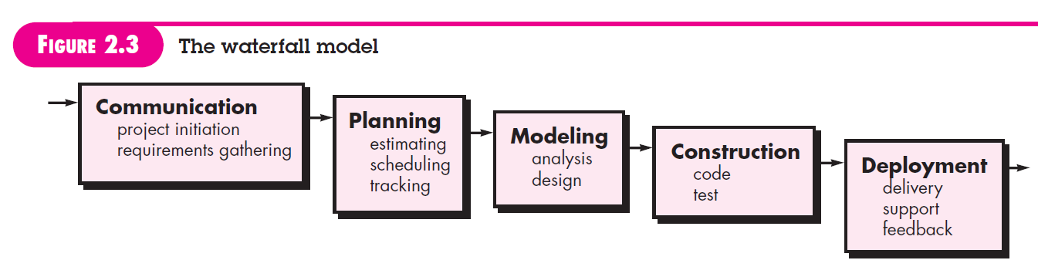

Slide 5
Among the problems that are sometimes encountered when the waterfall model is applied are:
1. Real projects rarely follow the sequential flow that the model proposes. Although the linear model can accommodate iteration, it does so indirectly. As a result, changes can cause confusion as the project team proceeds
2. It is often difficult for the customer to state all requirements explicitly. The waterfall model requires this and has difficulty accommodating the natural uncertainty that exists at the beginning of many projects.
3. The customer must have patience. A working version of the program(s) will not be available until late in the project time span. A major blunder, if undetected until the working program is reviewed, can be disastrous.

Slide 6
V-MODEL
A variation in the representation of the waterfall model is called the V-model. Represented in Figure 2.4, the V-model depicts the relationship of quality assurance actions to the actions associated with communication, modeling, and early construction activities.
As a software team moves down the left side of the V, basic problem requirements are refined into progressively more detailed and technical representations of the problem and its solution.
Once code has been generated, the team moves up the right side of the V, essentially performing a series of tests (quality assurance actions) that validate each of the models created as the team moved down the left side.
In reality, there is no fundamental difference between the classic life cycle and the V-model. The V-model provides a way of visualizing how verification and validation actions are applied to earlier engineering work.

Slide 7
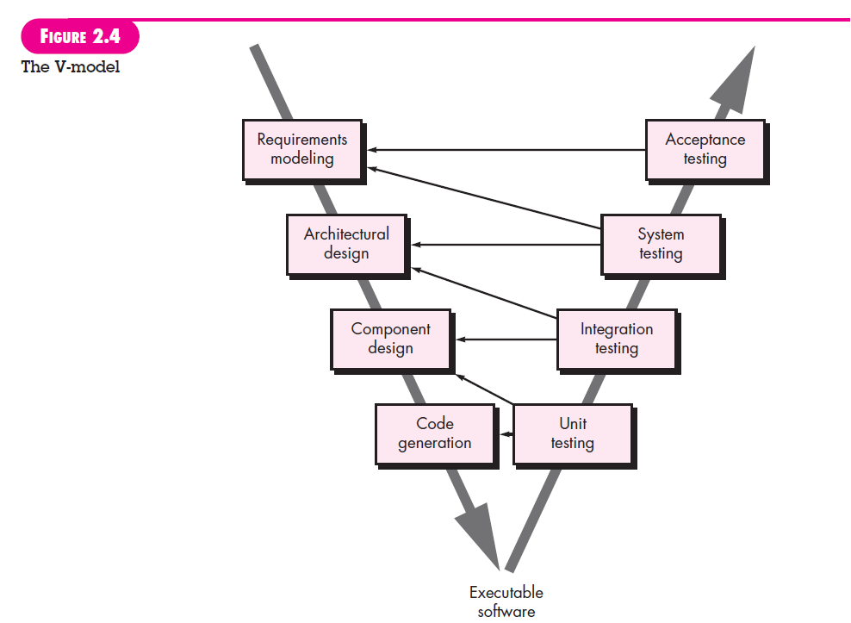

Slide 8
INCREMENTAL PROCESS MODELS
There may be a compelling need to provide a limited set of software functionality to users quickly and then refine and expand on that functionality in later software releases.
For example, word-processing software developed using the incremental paradigm might deliver basic file management, editing, and document production functions in the first increment; more sophisticated editing and document production capabilities in the second increment; spelling and grammar checking in the third increment; and advanced page layout capability in the fourth increment.
It should be noted that the process flow for any increment can incorporate the prototyping Paradigm.
When an incremental model is used, the first increment is often a core product. That is, basic requirements are addressed but many supplementary features (some known, others unknown) remain undelivered. The core product is used by the customer (or undergoes detailed evaluation). As a result of use and/or evaluation, a plan is developed for the next increment.

Slide 9
The plan addresses the modification of the core product to better meet the needs of the customer and the delivery of additional features and functionality. This process is repeated following the delivery of each increment, until the complete product is produced.
Incremental development is particularly useful when staffing is unavailable for a complete implementation by the business deadline that has been established for the project.

Slide 10
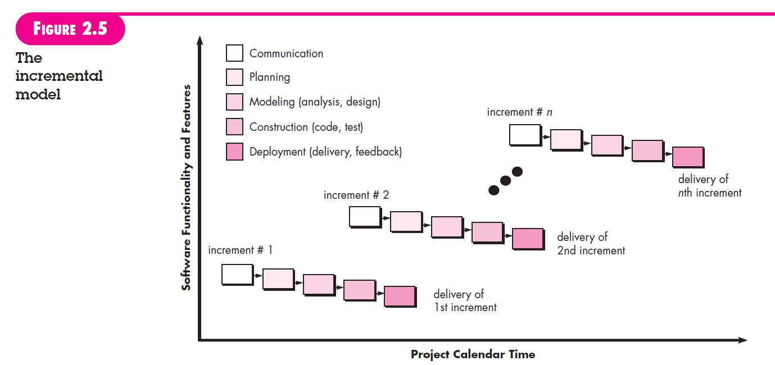

Slide 11
Evolutionary Process Models
Process model that has been explicitly designed to accommodate a product that evolves over time.
Evolutionary models are iterative.
They are characterized in a manner that enables you to develop increasingly more complete versions of the software.

Slide 12
PROTOTYPING
Often, a customer defines a set of general objectives for software, but does not identify detailed requirements for functions and features.
In other cases, the developer may be unsure of the efficiency of an algorithm, the adapt ability of an operating system, or the form that human-machine interaction should take.
In these, and many other situations, a prototyping paradigm may offer the best approach. The prototyping paradigm (Figure 2.6) begins with communication.
You meet with other stakeholders to define the overall objectives for the software, identify whatever requirements are known, and outline areas where further definition is mandatory.

Slide 13
A prototyping iteration is planned quickly, and modeling (in the form of a “quick design”) occurs. A quick design focuses on a representation of those aspects of the software that will be visible to end users (e.g., human interface layout or output display formats).
The quick design leads to the construction of a prototype. The prototype is deployed and evaluated by stakeholders, who provide feedback that is used to further refine requirements.
Iteration occurs as the prototype is tuned to satisfy the needs of various stakeholders, while at the same time enabling you to better under stand what needs to be done.
Although some prototypes are built as “throwaways,” others are evolutionary in the sense that the prototype slowly evolves into the actual system.

Slide 14
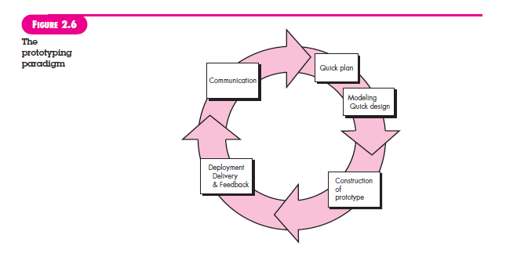

Slide 15
The Spiral Model
Originally proposed by Barry Boehm, the spiral model is an evolutionary software process model that couples the iterative nature of prototyping with the controlled and systematic aspects of the waterfall model.
It provides the potential for rapid development of increasingly more complete versions of the software.
Using the spiral model, software is developed in a series of evolutionary releases.
During early iterations, the release might be a model or prototype. During later iterations, increasingly more complete versions of the engineered system are produced.
A spiral model is divided into a set of framework activities defined by the software engineering team. For illustrative purposes, the generic framework activities.
Each of the framework activities represent one segment of the spiral path illustrated in Figure 2.7. As this evolutionary process begins, the software team performs activities that are implied by a circuit around the spiral in a clockwise direction, beginning at the center.

Slide 16
Risk is considered as each revolution is made. Anchor point milestones—a combination of work products and conditions that are attained along the path of the spiral—are noted for each evolutionary pass.
The first circuit around the spiral might result in the development of a product specification; subsequent passes around the spiral might be used to develop a prototype and then progressively more sophisticated versions of the software.
Each pass through the planning region results in adjustments to the project plan. Cost and schedule are adjusted based on feedback derived from the customer after delivery.
In addition, the project manager adjusts the planned number of iterations required to complete the software. The spiral model can be adapted to apply throughout the life of the computer software.
Therefore, the first circuit around the spiral might represent a “concept development project” that starts at the core of the spiral and continues for multiple iterations until concept development is complete. development is complete.

Slide 17
If the concept is to be developed into an actual product, the process proceeds outward on the spiral and a “new product development project” commences.
The new product will evolve through a number of iterations around the spiral. Later, a circuit around the spiral might be used to represent a “product enhancement project.” In essence, the spiral, when characterized in this way, remains operative until the software is retired.
There are times when the process is dormant, but whenever a change is initiated, the process starts at the appropriate entry point (e.g., product enhancement).

Slide 18
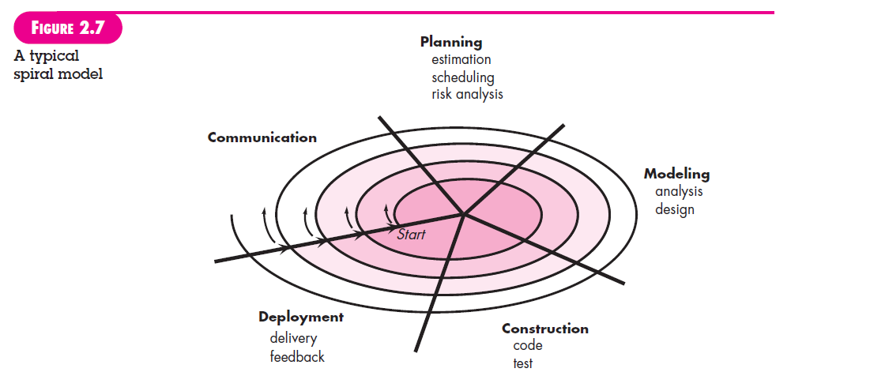

Slide 19
Concurrent Models
Figure 2.8 provides a schematic representation of one software engineering activity within the modeling activity using a concurrent modeling approach. The activity—modeling—may be in any one of the states noted at any given time.
Similarly, other activities, actions, or tasks (e.g., communication or construction) can be represented in an analogous manner.
All software engineering activities exist concurrently but reside in different states.
For example, early in a project the communication activity (not shown in the figure) has completed its first iteration and exists in the awaiting changes state. The modeling activity which existed in the inactive state while initial communication was completed, now makes a transition into the under development state.
If, however, the customer indicates that changes in requirements must be made, the modeling activity moves from the under development state into the awaiting changes state.

Slide 20
Concurrent modeling defines a series of events that will trigger transitions from state to state for each of the software engineering activities, actions, or tasks.
For example, during early stages of design (a major software engineering action that occurs during the modeling activity), an inconsistency in the requirements model is uncovered.
This generates the event analysis model correction, which will trigger the requirements analysis action from the done state into the awaiting changes state.

Slide 21
